Slide 1
Module 3
Building AI Agents with AutoGen

Slide 2
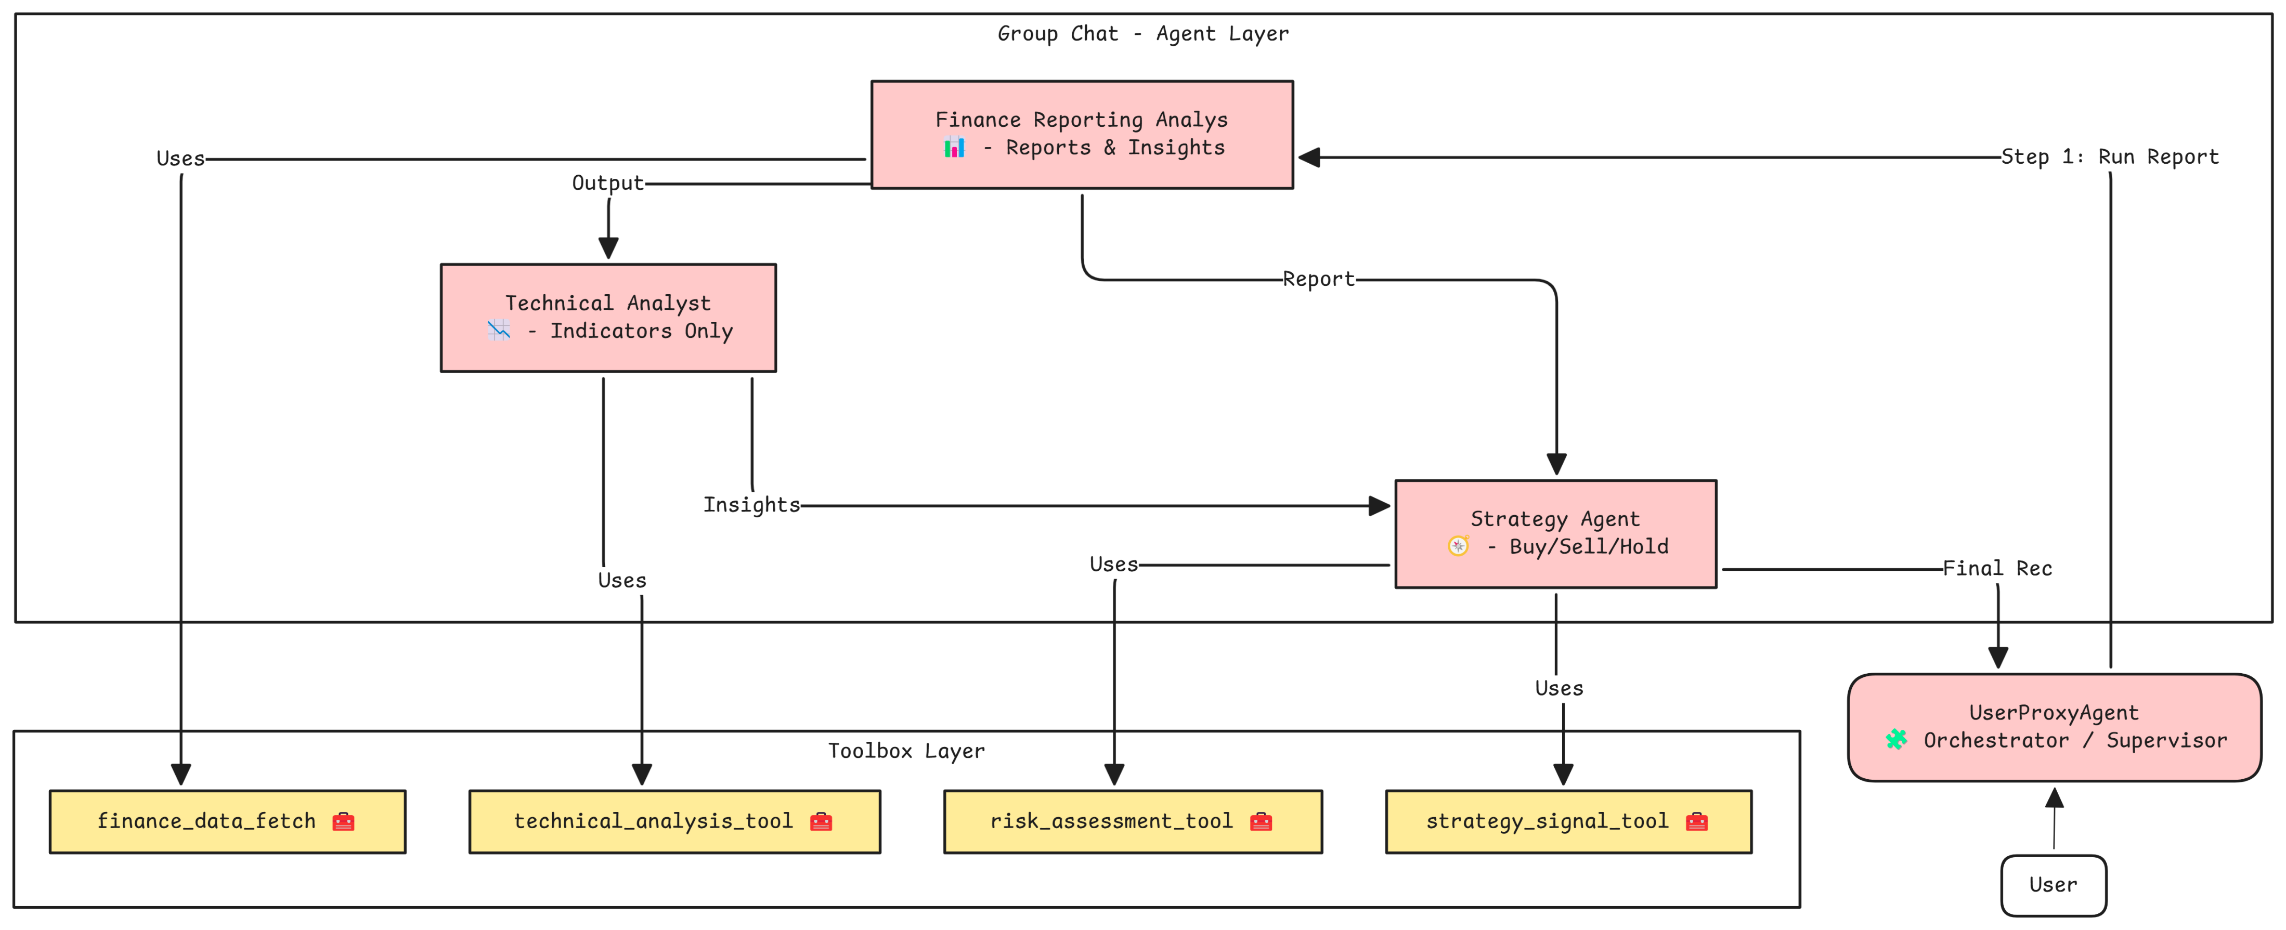
Agents and Tools for Financial Analysis

Slide 3
Agent Orchestration – Group Chat
Workflow:
Step 1: Register Tools
Technical Analysis → technical_analyst
Risk Assessment & Strategy Signal → strategy_agent
Data Fetch → finance_reporting_analyst
Step 2: Initiate GroupChat
Participants: user, finance_reporting_analyst, technical_analyst, strategy_agent
Orchestration via GroupChatManager
LLM Config: temperature=0.5, timeout=280s
Step 3: Execute User Request
Chat flow: Round-robin speaker selection
Results retrieved from chat_history or summary

